Slide 1
Curve-Fitted Instant Segmentation
CAPSTONE PROJECT PRESENTATION
Name: Pee Kian Soon
Group No. 7
Date: 6th Oct 2021
Supervisor: Dr. Tan Jen Hong
OVER

Slide 2
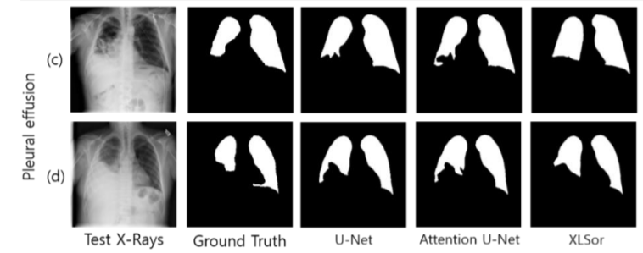
Problem Statement
State-of-the-art segmentation models generate contours that are hard and inefficient to edit
Especially for complex shapes with high texture variability, unclear boundary
Further compounded with training data shortages

Slide 3
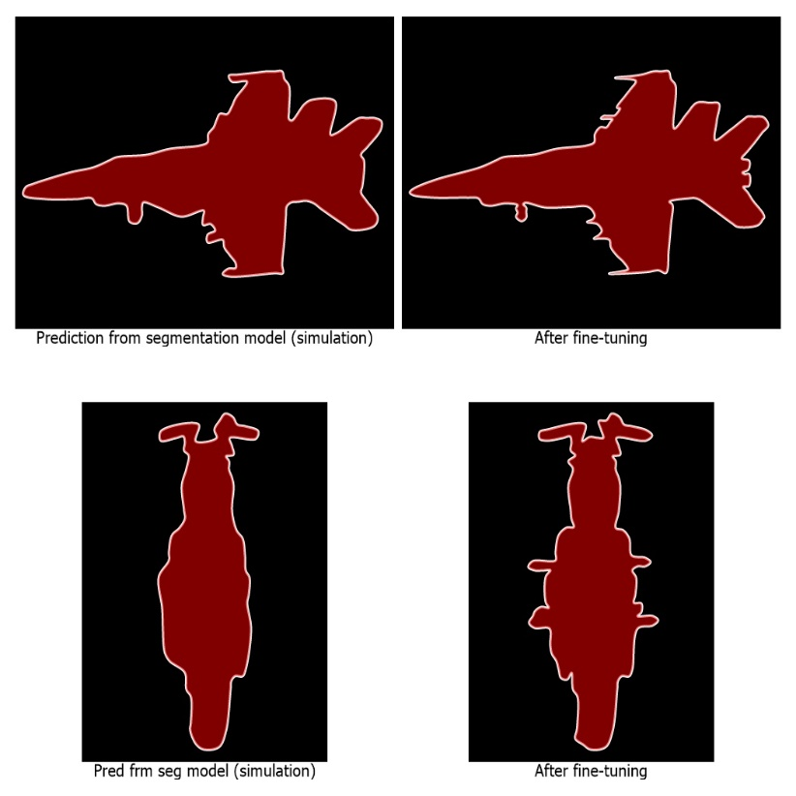
Solution
Create more advanced segmentation model?
Instead of creating new segmentation models, look at how segmentation output can be modified to a form that allows easy editing by end-user

Slide 4
How to Achieve this?
Extract contour coordinates of mask
Feed these coordinates to a trained DL model* to predict the set of salient points for mask contour representation
Perform curve fitting (via Centripetal Catmull-Rom Spline) on these points to reconstruct the mask
Create JavaScript UI and training dataset to enable the above tasks
*This Deep Learning Model is a sequence classification model (created by this project); not to be confused with the segmentation model (UNET, YOLOACT) which produces the initial mask.

Slide 5
Project Objectives & Deliverables
Objectives:
Investigate how the output of segmentation models (UNET, YOLOACT, etc) can be modified to a form that allows easy editing by end-user directly
Deliverables:
1. Deep Leaning Model
For predicting the set of salient points for mask contour representation
2. JavaScript UI
For mask reconstruction (using salient points predicted by DL model)
For fine-tuning reconstructed mask
For creating a dataset to train the DL model
3. Dataset [Centripetal Spline Fitted Dataset (CSF-DS)]
For training the DL Model

Slide 6
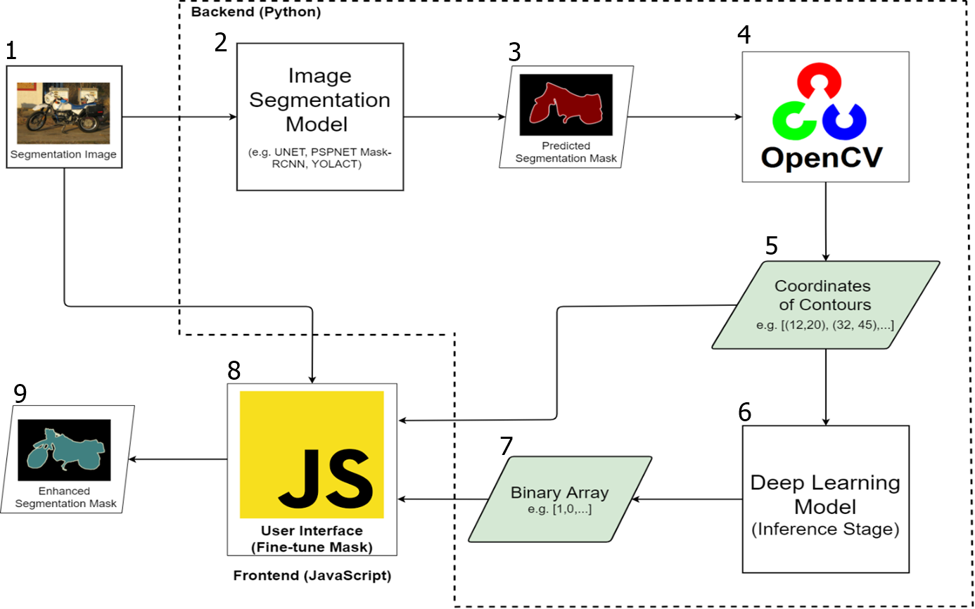
System Architecture

Slide 7
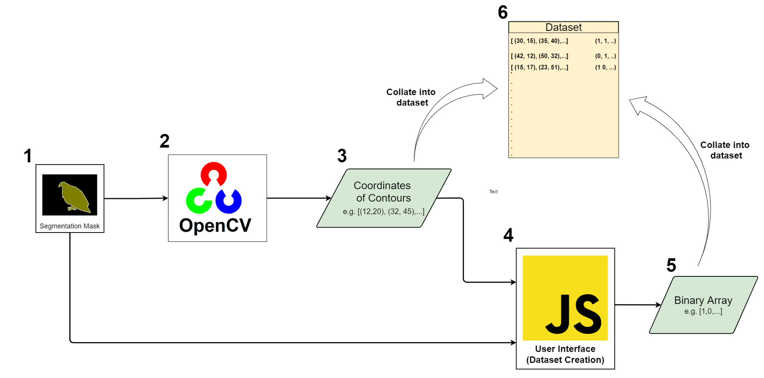
Dataset Creation Process

Slide 8
JavaScript UI Demonstration
3 minutes Video Demo
Dataset Creation Process
Mask Fine-tuning Process
C:\Users\ASUS\Desktop\Video\Project Demo.mp4

Slide 9
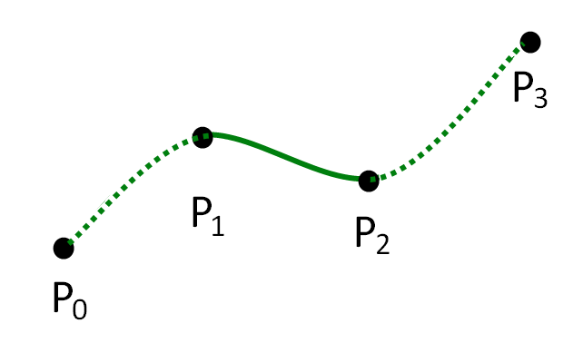
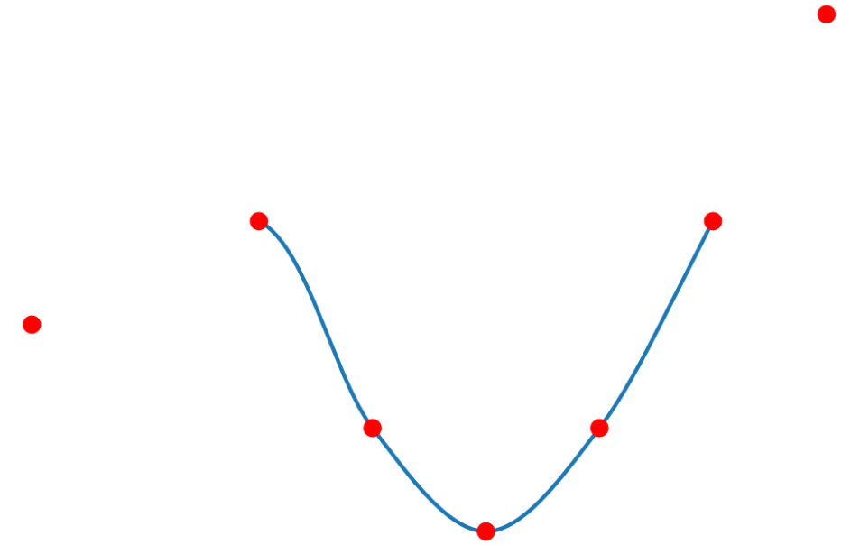
Centripetal Catmull-Rom Spline
Splines commonly used in computer graphics to draw smooth curve
Many types of splines curves; Bezier, B-splines, Catmull Rom, etc.
Centripetal Catmull Rom Spline > best properties among all
Each segment has 4 control points, but actual curve only goes through middle 2 points
One segment of centripetal spline
Join multiple segments to form smooth curve

Slide 10
Curve Fitting Via Centripetal Catmull-Rom Spline
Create a JavaScript UI that performs curve fitting and mask reconstruction
UI allows user to selectively remove points or reinstated removed points
Reconstruct contour by using centripetal splines to connect remaining points (curve fitting)
Reconstructed contours > reconstructed mask
Evaluation metric IOU for goodness of fit between original and reconstructed masks

Slide 11
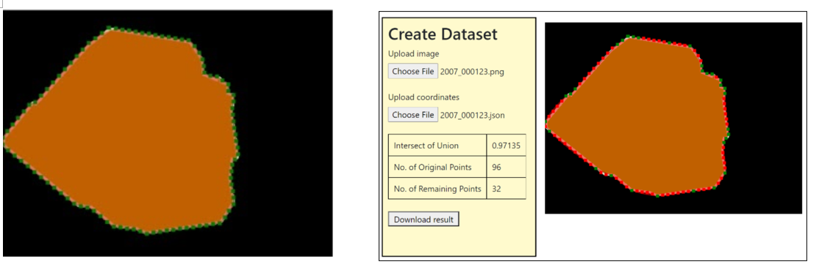
Curve Fitting Via Centripetal Catmull-Rom Spline
Green dot > original contour points
Red dot > removed points (by user using JS UI)
Remaining green dots > salient points of the mask
JS UI reconstruct mask by curve fitting (via centripetal spline) on remaining points
IOU determines goodness of fit between original and reconstructed mask

Slide 12
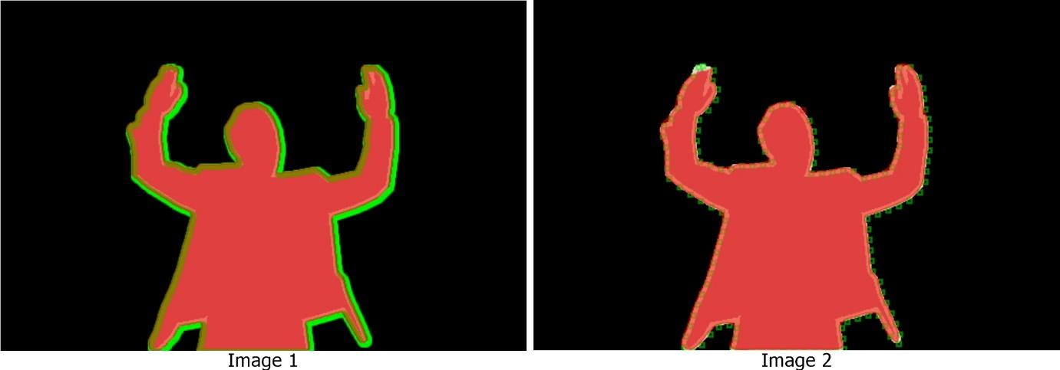
Extraction of Original Contour Points
Manual determine from Photoshop?
Via OpenCV
Convert to grayscale: cv.cvtColor()
Convert to binary: cv.threshold()
Extract contours: findContours()
Slicing ops on resulting contour coord list to obtain a manageable subset of coord.
Why perform slicing?

Slide 13
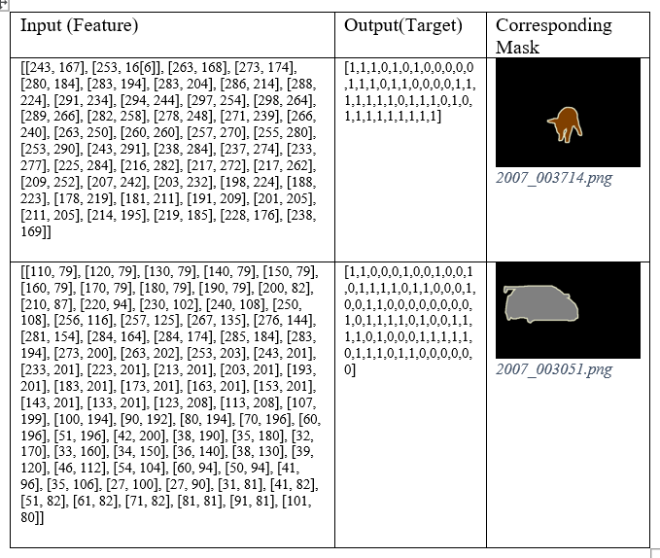
Centripetal Spline Fitted Dataset (CSF-DS)

Slide 14
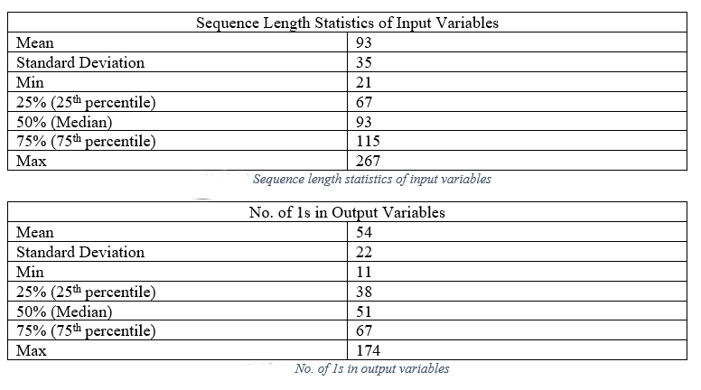
Centripetal Spline Fitted Dataset (CSF-DS)
Using mean value as gauge, no. of points needed to reconstruct mask can be reduced by more than 41%
On average out of 93 points; only 54 are salient points; the rest can be ignored

Slide 15
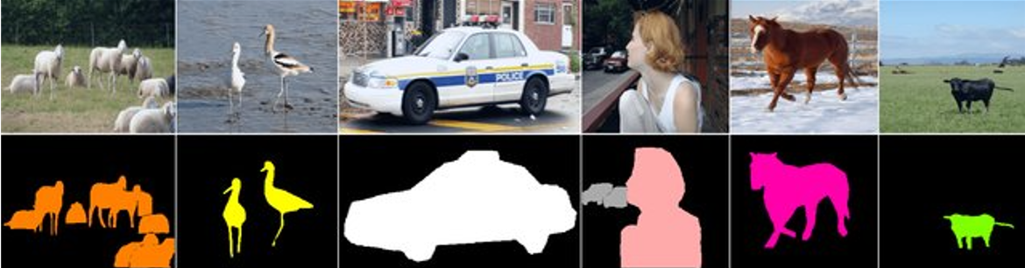
Source of Segmentation Mask
VOC Pascal 2011 Dataset
High subject variability: 2,223 segmentation images in 20 classes
Mask readily available in png format not in json format (like COCO)
50% consists of only one class, rest consists of more than one class
Project used only images with single class and instant

Slide 16
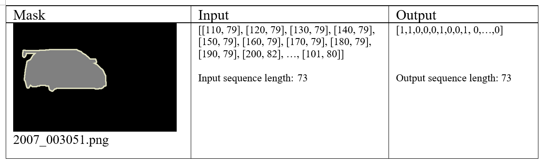
Deep Learning Model: Input/Output
Input: An array of integer coordinates of shape (n,2) that represents the mask contour, where n is the sequence length
Output: A array of binary values of shape (n, 1) where value 1 denotes point that should be included in the formation of spline, value 0 otherwise

Slide 17
Deep Learning Model: Dataset & Class Ratio
No. of training data: 414
No. of validation data: 46
No. of test data: 40
Class Ratio:
Class 0: 16,111
Class 1: 22,665
Padding*: 71,762
Model evaluation metrics: F1
*Depending on models, the paddings are either treated as Class '0' or a separate class (Class '2') by themselves.

Slide 18
Potential Deep Learning Models
Stacked Conv1D (with and w/o masking layer)
Conv1D + LSTM (with and w/o masking layer)
Seq2Seq (various configurations: uni/bidirectional LSTMs, stacked LSTMs, masking layer, data augmentation etc.)

Slide 19
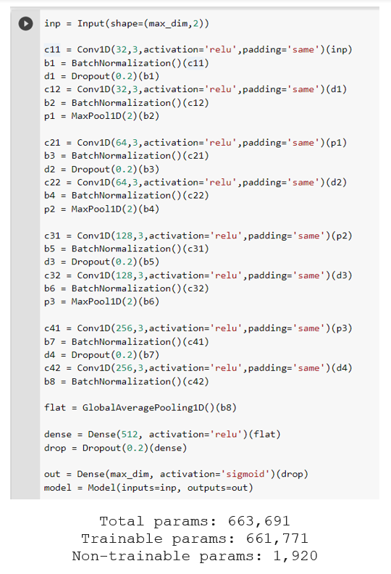
Stacked Conv1D – Architecture
Baseline model to compare against other models
Input → [batch-size, timesteps, features] Output → [batch-size, timesteps]
Input and output shorter than max seq length (267) padded with 500 and 0 resp.
Repeating blocks of Conv1D, BatchNormalsiation, Dropout, and MaxPool1D layers
Padding set to ‘same’ to maintain output dimension till next pooling layer
Sigmoid activation on last dense layer
Lost function → Binary cross-entropy. Evaluation metric → F1 score

Slide 20
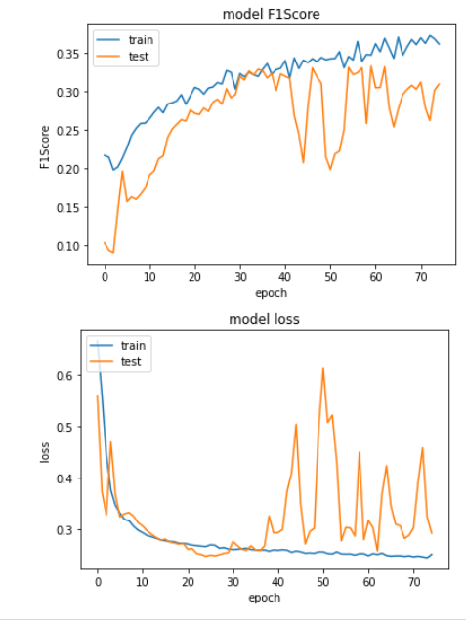
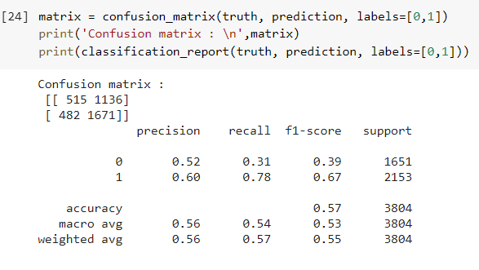
Stacked Conv1D – Result
F1 score reaches a maximum (~0.32) around the 30th epoch
Validation loss reaches a minimum (~ 0.3) around the 25th epoch
All metrics except for Class '1’ Recall have low values → lower false neg rate
Model tried not to predict true "1' as '0', but a significant number of ‘0' is wrongly predicted as ‘1’.
PS: No significant diff in perf with additional input masking layer.

Slide 21
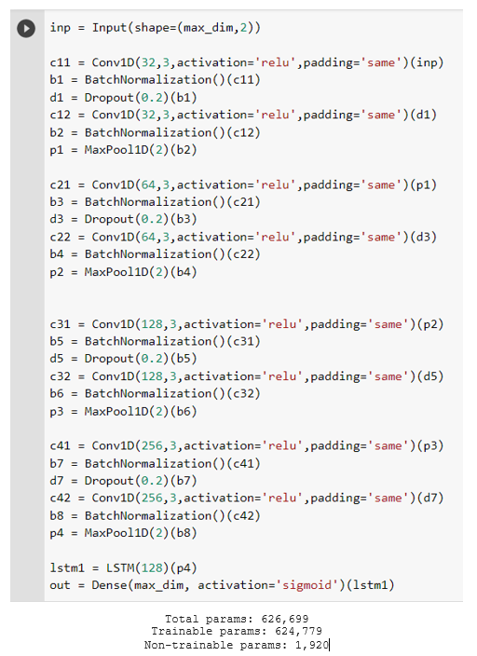
Conv1D + LSTM – Architecture
Stack of Conv1D, Batch Normalisation, Dropout, MaxPool1D as feature extractor
Connected to LSTM layer to extract further temporal feature
Input → [batch-size, timesteps, features] Output → [batch-size, time-steps]
Input and output shorter than max seq length (267) padded with 500 and 0 resp.
Padding set to ‘same’ to maintain output dimension till next pooling layer
Sigmoid activation on last dense layer
Lost function → Binary cross-entropy. Evaluation metric → F1 score

Slide 22
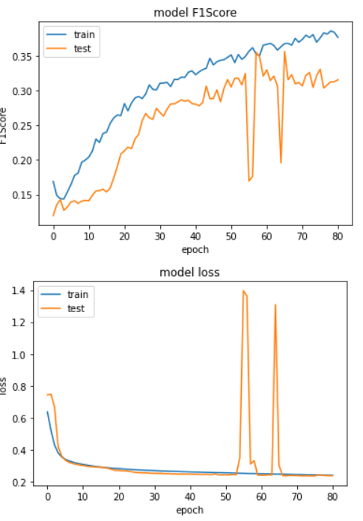
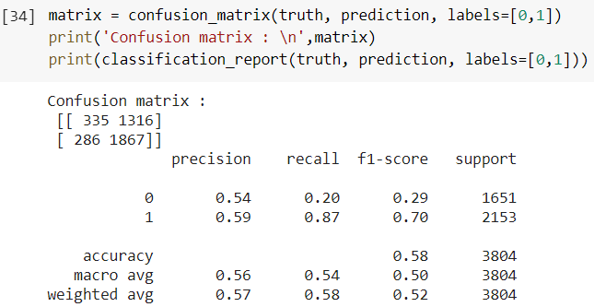
Conv1D + LSTM – Result
F1 score reaches a maximum (~0.33) around 58th epoch
Validation loss reaches a minimum (~ 0.23) around 60th epoch
All metrics except for Class ' 1’ Recall have low values → lower false neg rate
Generally not much difference in performance from stacked Conv1D model
PS: No significant diff in perf with additional input masking layer.

Slide 23
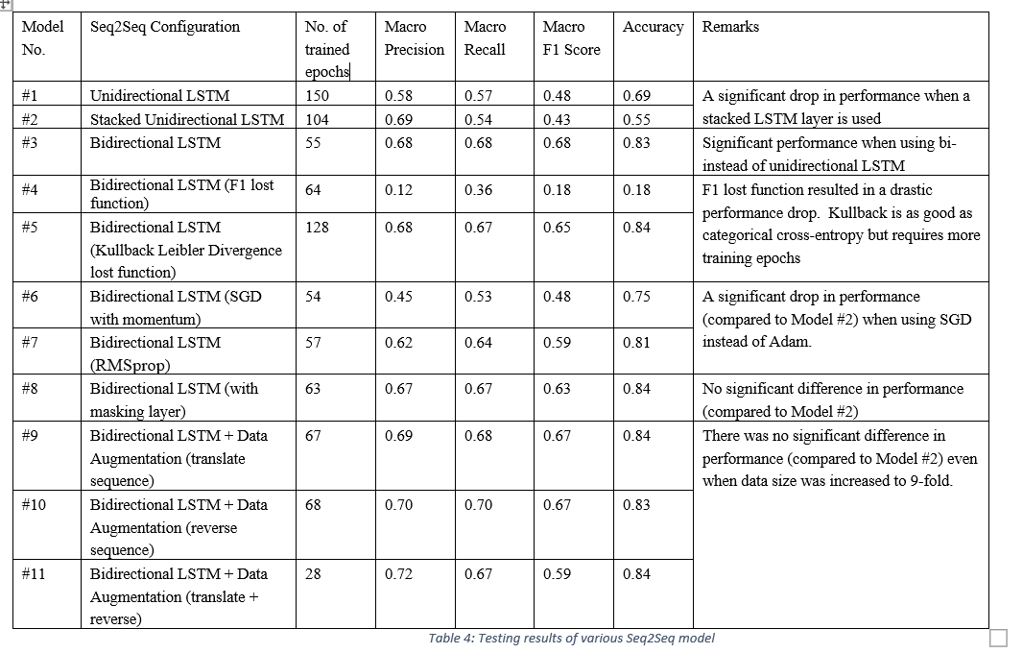
Seq2Seq – Architecture
Several Seq2Seq models with various designs (uni/bidirectional LSTMs, stacked LSTMs), hyperparameter settings (optimizer, lost function, masking layer) & input/out configurations (one-hot encoded, data augmentation) were experimented

Slide 24
Seq2Seq – Result
Bidirectional better performance than unidirectional LSTMs (increased up to 20% for F1 score)
Drop in performance with Stacked LSTMs (unidirectional)
Optimiser: ADAM and RMSprop better than SGD
Adam Lost function: Categorical cross-entropy & KLD better than F1
No significant difference in using masking layer or data augmentation (even when increased to 9-fold)
Best performing config: Bidirectional LSTMs (F1 score: 0.68; Accuracy: 0.83). Compared to Conv1d / Conv1d-LSTM (F1 score: 0.53-0.57)

Slide 25
Data Augmentation
Via Sequence translation and sequence reversal
Sequence translation: shifting all the coordinate points of the input sequence by an equal, fixed amount in x and y-directions
Sequence reversal: reversing sequence order in input and output
After translation ops (of 5 units):
(1, 3), (3, 4), (2, 6), (4, 7) → (0, 1, 1, 0) becomes
(6, 8), (8, 9), (7, 11), (9, 12) → (0, 1, 1, 0)
After reverse ops (to both input and output)
(2, 5), (3, 3), (4, 5), (8, 10) → (1, 1, 0, 0) becomes
(8, 10), (4, 5), (3, 3), (2, 5) → (0, 0, 1, 1)

Slide 26
Sliding Window to Reduce Sequence Length
Tried to resolve long term dependency issue by breaking up sequences into shorter and overlapping subsequences.
Three sliding windows (window-size 20, step-size 10), (20,10), and (30, 20) were attempted.
Remove any subsequence with length shorter than window size to eliminate need for padding
No improvement observed
Repeat experiment with data augmentation (up to 5-fold); no improvement observed too

Slide 27
Model verification Via Dummy Dataset
Two examples of dummy input and their corresponding output sequences are shown below:
(1,3), (3, 4), (2, 6), (4,7) → (0, 1, 1, 0)
(5,4), (3, 2), (4, 1) → (1, 0, 1)
where nth binary value is determined by the cumulative sum of integer coordinates in the input from the start to the nth sequence
if sum is even, output is 0 if sum is odd, output is1

Slide 28
Prediction Vs Ground Truth
Comparison between Ground Truth and Prediction masks

Slide 29
Conclusions - Overall Findings
Through contour points reduction and curve fitting, segmentation mask can be modified to a form that enables easy editing by end-user.
Among three models tested (Conv1d, Conv1d+LSTM, Seq2Seq), Seq2Seq gave the best performance (F1 score: 0.68, Acc: 0.83).
Conv1d & Conv1d+LSTM gave similar results (F1 score: 0.50-0.58).
Seq2Seq with bidirectional LSTM gave much better performance than unidirectional LSTM (~20% inc in F1 score)
Seq2Seq performance could not be further improved; likely due to bottleneck problem.
Data augmentation and Window sliding have no significant effect on performance; likely due to insufficient dataset and poor data augmentation.

Slide 30
Conclusions - Future Work
Increase size of CSF-DS via JS UI or data augmentation
Dataset creation process manual & tedious; automate/semi-automate via algorithms (rule based/GA)
Explore better data augmentation techniques
Explore more advanced DL techniques like Attention Mechanism (and maybe transformers)

Slide 31
Thank you! ☺

